Slide 1
Ionic Compounds

Slide 2
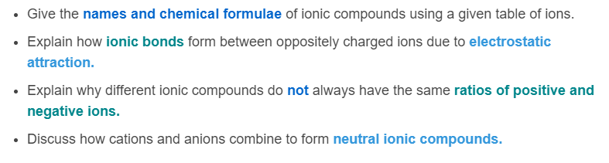
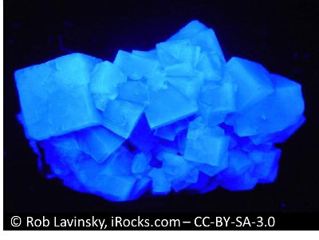
After you have completed this lesson you should be able to:

Slide 3
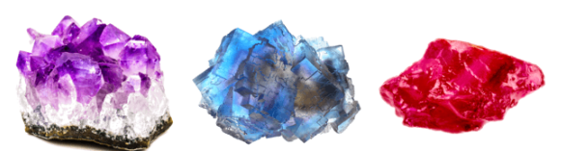
When atoms gain or lose electrons to become stable, they become charged particles: ions.
The electrons are transferred between atoms, forming cations (+) and anions (−). These cations and anions come together to form large crystal lattices called ionic compounds.

Slide 4

Ionic compounds are made up of cations and anions held together by strong electrostatic forces.
Ionic bonds are a type of chemical bond involving electrostatic attraction, which is the attractive force between ions with opposite electric charges.
Positively charged cations and negatively charged anions attract each other and bond together to form an ionic compound.

Slide 5
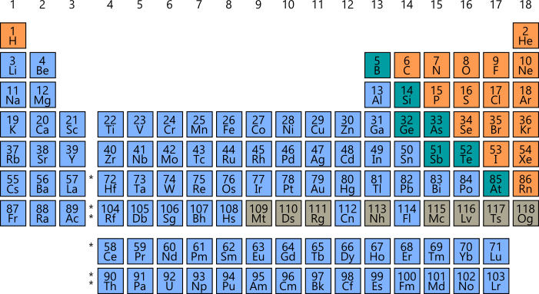
Metal atoms, found on the left-hand side of the periodic table, need to lose electrons to fill their valence shells and achieve stability. They form cations with a positive charge that is equal to the number of electrons lost.
Non-metal atoms, found on the right-hand side of the periodic table, need to gain electrons to fill their valence shells and achieve stability. They form anions with a negative charge that is equal to the number of electrons gained.

Slide 6
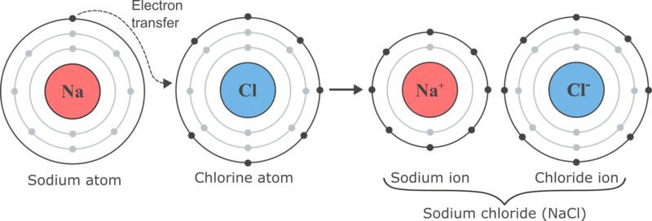
Let's look at the most well-known example of an ionic compound, sodium chloride (table salt).
The sodium atom (a metal) loses an electron to form a sodium ion (Na⁺). The electron is transferred to the chlorine atom (a non-metal). When chlorine gains the electron, a chloride ion (Cl⁻) is formed. The oppositely charged sodium and chloride ions are attracted to each other, and bond together to form the compound sodium chloride (NaCl).

Slide 7
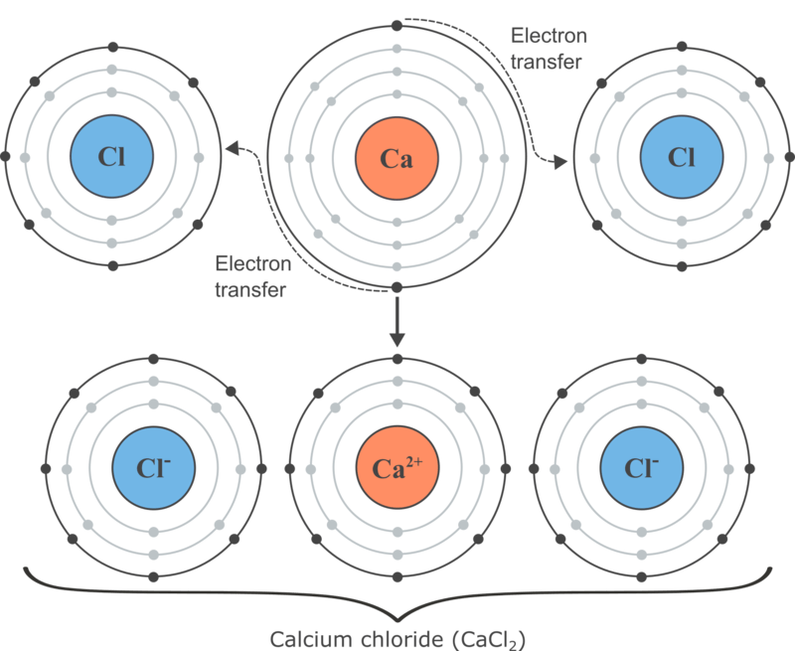
Another example of an ionic compound is calcium chloride.
Each calcium atom gives up two electrons in order to become stable, forming the cation Ca²⁺. It transfers one electron to each chlorine atom giving them each a charge of −1. The oppositely charged calcium and chloride ions are then attracted to each other and bond together to form the compound calcium chloride (CaCl₂​).

Slide 8
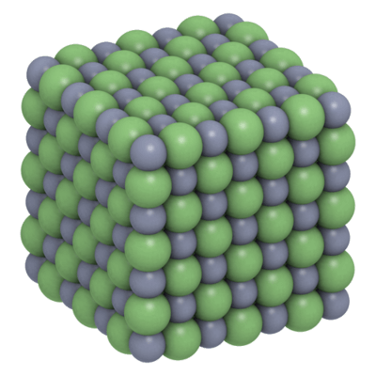
Unlike covalent compounds, such as water (H_{2​}O), ionic compounds do not contain individual molecules. Instead, they form crystal lattices.
A crystal lattice is a repeated arrangement of ions in 3 dimensions. For example, the image below shows what the structure of a sodium chloride crystal would look like up close. Each cation in the lattice is surrounded by anions, and each anion is surrounded by cations.

Slide 9
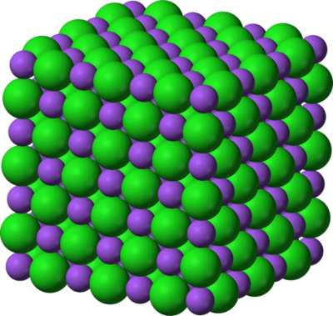
Ionic compounds are always neutral (uncharged) overall.
Positive charges (from cations) and negative charges (from anions) need to cancel each other out.
If the charges on the cations and anions are the same (e.g. 1+ and 1−), a simple crystal lattice with equal numbers of anions and cations is formed.

Slide 10
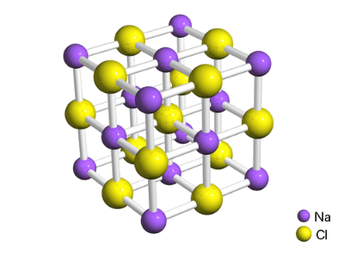
We can write the chemical formula of an ionic compound to show the relative numbers of cations and anions it contains.
For example, the formula for sodium chloride is NaCl. For every one sodium ion, there is one chloride ion. The ratio of cations to anions in the crystal lattice is 1:1.
It is important to note that this is a ratio. It does not tell you the actual number of ions in a crystal of sodium chloride. In fact, a single salt crystal contains approximately one quintillion (10¹⁸) ions!

Slide 11
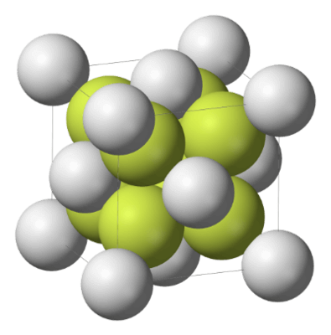
If the charges on the ions are not of the same magnitude, there will be more of one type of ion than the other in order to make the ionic compound neutral overall.
For example, a crystal of calcium fluoride (CaF_{2​}, shown below) has twice as many F⁻ ions as Ca²⁺ ions, so that it has no overall charge. The ratio of cations to anions in the crystal lattice is 1:2.

Slide 12
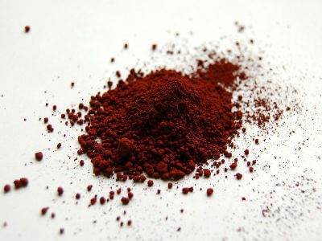
In order to write the chemical formula of an ionic compound, we first need to work out what the ratio of cations to anions will be. The charges must balance in order to make the compound neutral overall.
For example, let's look at iron(III) oxide. It contains the ions Fe³⁺ and O²⁻. What ratio of ions does the crystal lattice need to contain in order to be electrically neutral?

Slide 13
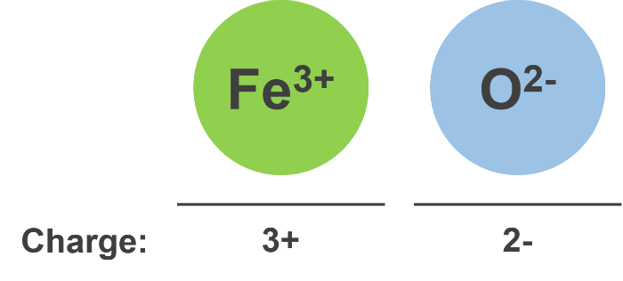
If we start with one of each ion, we can see that the charges do not balance out:

Slide 14
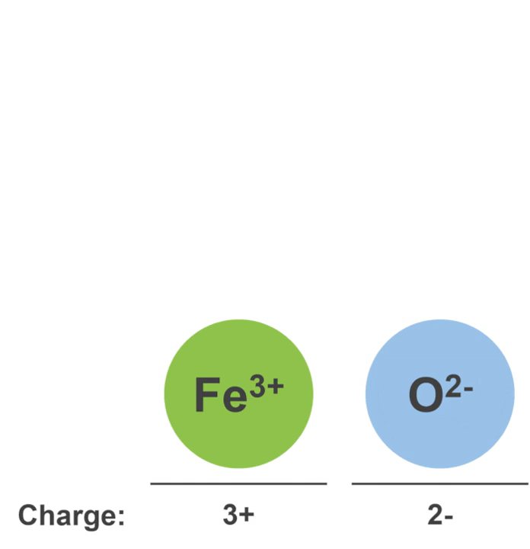
We can continue adding cations and anions until the positive and negative charges balance out. Looking at the image below, you can see that we need two Fe³⁺ ions, and three O²⁻ ions to make the charges balance. The ratio of cations to anions in iron(III) oxide is therefore 2:3.

Slide 15

One important thing to remember when writing ratios is that the side of the colon on which you place each number does matter.
If you are talking about a ratio of cations to anions, this is written in the form cations : anions.
For example, if there are three cations and two anions, you would write the ratio as 3:2. If there are two cations and three anions, you would write the ratio as 2:3. These are not the same thing.

Slide 16

Once we've figured out the ratio of cations to anions in an ionic compound, we can write its chemical formula.
Writing a chemical formula for an ionic compound is a way of showing how many of each type of ion you need in order for the compound to be neutral.
The formula is written:
Cation first, anion second.
Showing the simplest ratio of ions that balances the positive and negative charges.
Without showing charges on ions.

Slide 17
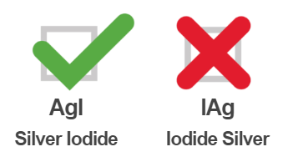
When writing the name or formula of an ionic compound, the metal ion (cation) is always written first and the non-metal ion (anion) is always written second. The charges on the ions are not included in the chemical formula.
For example, an ionic compound made up of silver (Ag⁺) and iodide (I⁻) ions is called silver iodide and not iodide silver.
Its chemical formula is written AgI and not IAg.

Slide 18
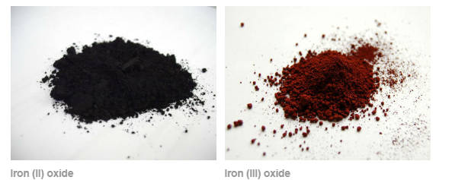
You also must include any Roman numerals in the name of a compound, where they are required to identify the charge on the ion. This lets other people know what the chemical formula of the compound is.
For example, iron(II) (Fe²⁺⁾ and iron(III) (Fe³⁺) ions both form compounds with oxide ions (O²⁻). Iron(II) oxide has the chemical formula FeO while iron(III) oxide has the chemical formula Fe₂​O₃​.

Slide 19
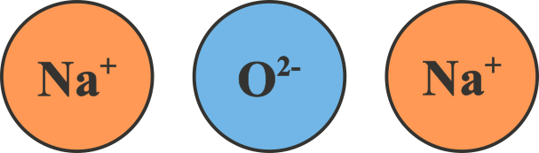
Subscript numbers in chemical formulae tell you the number of each type of atom in the compound. The number relates to the atom it follows.
For example, sodium oxide has the formula Na₂​O. The number 2 after sodium tells you that there are two sodium ions. When there is no number, such as after oxide, it means there is only one of that ion. Sodium oxide has two sodium ions for every one oxide ion.

Slide 20
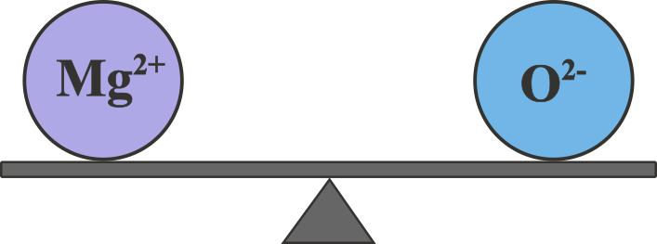
You will need to be able to determine the formula of an ionic compound that will form from any given combination of ions. However, this is easy to do once you have worked out the ratio of ions.
If the ions in the compound have a 1:1 ratio, the charges are balanced. This means we won’t have to write any subscript numbers in the formula.
For example, magnesium oxide is made up of Mg²⁺ ions and O²⁻ions. These charges will cancel each other out, and the formula will simply be MgO.

Slide 21
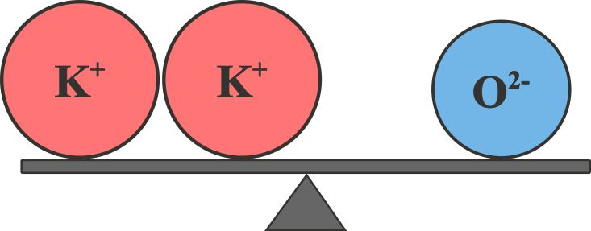
However, a potassium ion has a charge of ⁺¹, so potassium oxide will have a 2:1 ratio of potassium ions to oxide ions. We can show this in the formula of potassium oxide by writing a subscript 2 after the potassium: K_{2​}O.
This tells us that two potassium ions (K⁺) are required to balance the charge of one oxide ion (O²⁻) to make the compound neutral.

Slide 22
